Slide 1

FUNDAMENTAL ANALYSIS
FINM 693
CREDIT 3
Basit Ali Bhat
Teaching Assistant

Slide 2
FUNDAMENTAL ANALYSES
QUALITATIVE ANALYSES
Management
Corporate Governance
Research & Development
Labour Relations
Company Culture
Competitive Advantage
Industry type
QUANTITATIVE ANALYSES
Balance Sheet
Profit And Loss
Cash Flow

Slide 3
Pillars Of Fundamental Analyses
Economy Analyses
GDP
Inflation
Interest rates
Forex reserves (Balance of Payment)
Monsoon
Political stability

Slide 4
INDUSTRY/SECTOR ANALYSES
Overall knowledge about the sector or industry investors want to invest in
Identify the area where strategic changes will help to maximize profitability
Assess the future prospects of the company through industry or sector analyses
Forecast the actions taken up by potential competitors
One sector can have various industries

Slide 5
INDUSTRY
An industry is a group of companies that are related based on their primary business activities
An industry is a group of manufacturers or businesses that produce a particular kind of goods or services.

Slide 6
Industry Rivalry and Competition
Price Competition
Product Introductions
Slow Industry Growth
High strategic stake
High exit barriers
Economic, strategic, and emotional factors can prevent companies from leaving the industry, even when they are earning low or negative returns on investments. Major sources of exit barriers include:
Specialized assets
Fixed costs of exit
Strategic interrelationships
Emotional barriers
Government and social restrictions

Slide 7
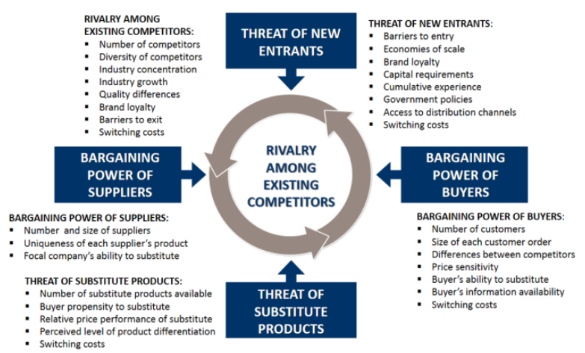
Porter’s Five Forces Model

Slide 8
HOW INDUSTRIES CHANGE
There are two types of threats to industries
The first is a threat to the industry’s core activities—the activities that have historically generated profits for the industry
These are threatened when they become less relevant to suppliers and customers because of some new, outside alternatives like car dealerships.
The second is a threat to the industry’s core assets—the resources, knowledge, and brand capital that have historically made the organization unique. PATENT EXPIRATION

Slide 9
TRAJECTORIES OF INDUSTRY CHANGE
Radical change (Government regulations and change of taste, travel industry, cellular telephones)
Intermediate change (music industry, auto dealership)
Creative change (relations with customers and suppliers are stable) Film Industry
Progressive change (Feedback, airline industry)
Identify Trajectory
Define your industry
Define industry core assets and activities
Determine whether core assets and activities are threatening with obsolescence
Evaluate where the industry is in the cycle

Slide 10
Business Cycle
A business cycle refers to the periodic expansion and contraction of a nation’s economy.
The business cycle refers to fluctuations in the economy between periods of expansion (growth) and contraction (recession).
The recurring and fluctuating levels of economic activities that an economy experiences for a long period of time.
A cycle consists of expansion, recession, contraction, and revival

Slide 11
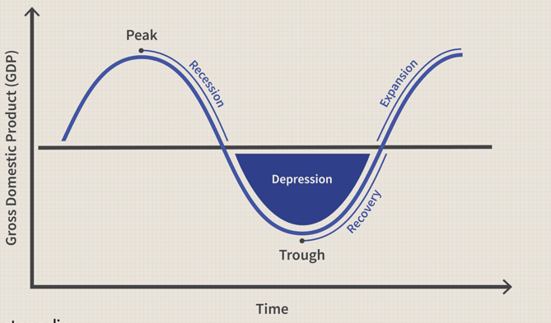
Business Cycle

Slide 12
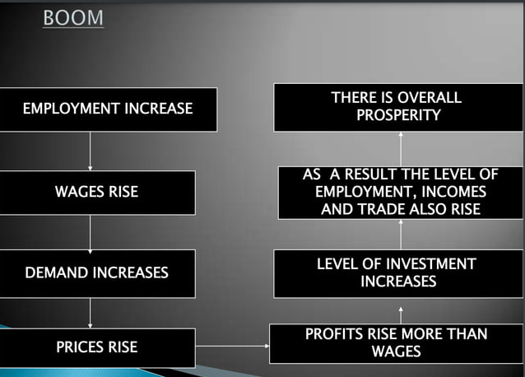

Slide 13
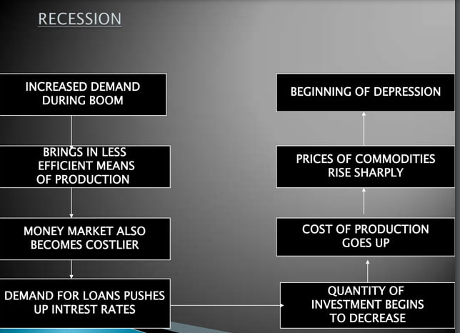

Slide 14
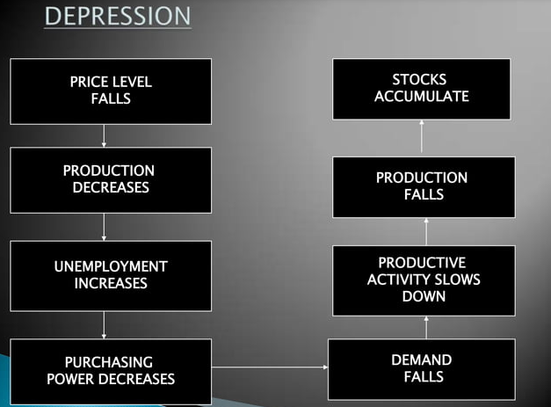

Slide 15
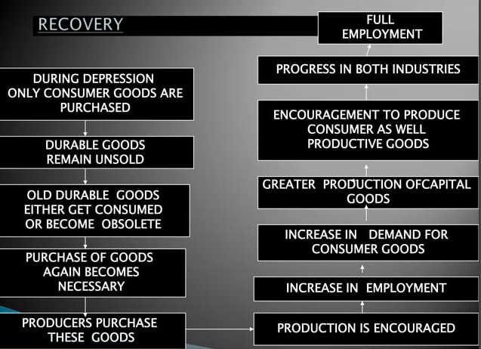

Slide 16
Investing During Business Cycle
During the recession phase, the lowest point in the business cycle, economic activity is at its weakest, and unemployment is at its highest. Many industries may struggle during this phase, especially those dependent on consumer spending or business investment.
However, certain industries are able to weather the storm during a recession because they offer products and services that people need no matter how the economy is performing. These industries include healthcare, consumer staples, and utilities.
Early Cycle (Start of Expansion)
Mid-Cycle (Full Capacity)
Late Cycle

Slide 17
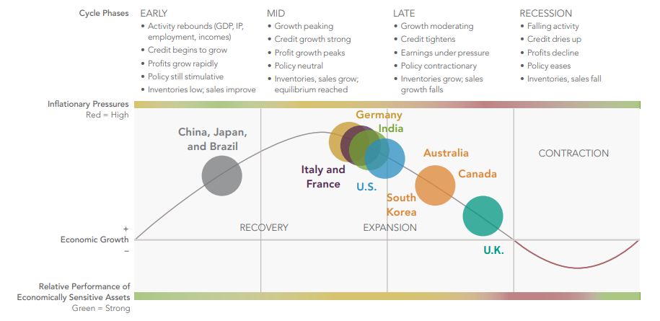

Slide 18
Consumer Goods: Automotive, Housing, And Retail And Finance
It And Basic Material
Energy, Utilities, Healthcare, And Consumer Staples.

Slide 19
INDUSTRY LIFE CYCLE
WHY INDUSTRY LIFE CYCLE
Industries go through different stages in their lifetime which affects their existence or survival
It makes investors understand where is particular industry standing at A particular time and situation
It guides investors to make strategies according to the cycle industry goes through

Slide 20
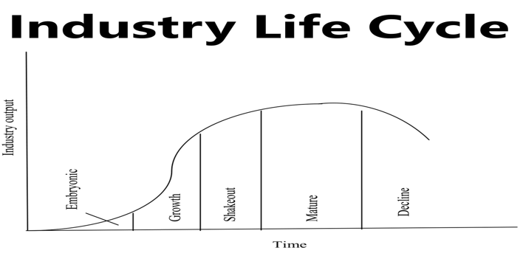
INDUSTRY LIFE CYCLE

Slide 21
INDUSTRY LIFE CYCLE
EMBRYONIC STAGE
GROWTH STAGE
SHAKEOUT
MATURE
DECLINE

Slide 22
INDUSTRY LIFE CYCLE
2. EMBRYONIC STAGE
An industry just beginning to develop, characterized by slow growth, high prices, low volumes, a substantial need for investment, and a high risk of failure.
Challenge is to educate customers, open up distribution channels, and design the perfect product

Slide 23
INDUSTRY LIFE CYCLE
1. GROWTH STAGE
Characterized by rapidly increasing demand, improving profitability, falling prices, and relatively low competition
Prices fall
Everyone has a scope to grow
Demand Grows
Market research

Slide 24
INDUSTRY LIFE CYCLE
3. SHAKEOUT STAGE
Characterized by slowing growth, intense competition, declining profitability, and a focus on cost reduction
Demands saturate
First-time buyers decline
Rivalry high
Chances of loss

Slide 25
INDUSTRY LIFE CYCLE
4. MATURITY STAGE
At this Stage the majority of companies are well established and the industry reaches its saturation point
Characterized by little or no growth, industry consolidation, and high barriers to entry.
Companies collectively attempt to deter new competitors in the industry
Maximum revenue
Profits
High demand
Product Popularity
Reasonable prices

Slide 26
INDUSTRY LIFE CYCLE
4. DECLINE STAGE
Characterized by negative growth, excess capacity, and intense competition.
Technology Changes
Social Changes
Demographic Change
International Competition
Decline of competition based on several reasons
Larger companies acquire small players
Disinvestment in case of huge losses

Slide 27
INDUSTRY LIFE CYCLE
QUESTIONS
PRINT MEDIA?
SOLAR INDUSTRY?
MICROPROCESSORS?
AUTOMOBILE INDUSTRY?

Slide 28
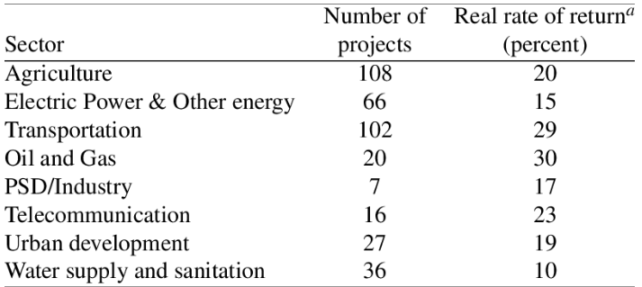
INDUSTRY RATE OF RETURN

Slide 29
INDUSTRY RATE OF RETURN
COMPANY | RETURNS | INDUSTRY RETURNS
HERO | 10% | 12%
BAJAJ | 9%
HONDA | 7%
YAMHAHA | 6.5%
SUZUKI | 7.23%
TVS | 4%

Slide 30
RELATIVE VALUATION
A type of business valuation method that analyzes the value of a company to the value of its competitors or industry peers in order to determine the financial worth of such a company
It makes use of multiples, averages, ratios, and benchmarks to determine a company's worth.
It is also used by investors to make informed decisions before buying a company's stock

Slide 31
RELATIVE VALUATION
P/E RATIO
P/B RATIO
PRICE TO FREE CASH FLOW
ENTERPRSIE VALUE/EBITDA

Slide 32
P/E RATIO
Price to Earnings Ratio or Price to Earnings Multiple is the ratio of the share price of a stock to its earnings per share (EPS). PE ratio is one of the most popular valuation metrics of stocks. It provides an indication whether a stock at its current market price is expensive or cheap
P/E = Market price per share/earning per share

Slide 33
P/B RATIO
The price-to-book (P/B) ratio measures the market's valuation of a company relative to its book value. The market value of equity is typically higher than the book value of a company's stock
P/B Ratio = Market Value Per Share/Book Value Per Share

Slide 34
PRICE TO FREE CASH FLOW
Price to free cash flow removes capital expenditures, working capital, and dividends so that you compare the cash a company has left over after obligations to its stock price
P/CF Ratio = Market Capitalisation/Cash From Operations

Slide 35
ENTERPRSIE VALUE/EBITDA
Enterprise Valuation ratios are used to determine the current value of the firm. And these ratios also help in determining whether the firm is undervalued or overvalued. EV to EBITDA is a popular valuation metric known as Enterprise multiple or EBITDA multiple. Therefore, through this metric, enterprise calculation determines whether the firm is undervalued or overvalued. EV/EBITDA calculation happens by dividing Enterprise Value (EV) by Earnings before Interest Tax Depreciation & Amortization (EBITDA).
ENTERPRISE VALUE = assets+ investments+ profits +debts
EBITDA = PROFITS + INTEREST + TAX+ DEP + AMORTISATION

